Slide 1
ISAGCA Webinar Series
Zero Trust Outcomes Using ISA/IEC 62443 Standards
Link to Whitepaper
Authors/Presenters:
Andrew Kling , VP Cybersecurity, Schneider Electric
Bob Pingel, OT Cybersecurity Strategist, Rockwell Automation
Danielle Jablanski, ICS cybersecurity strategist CISA

Slide 2
Andrew Kling, VP Cybersecurity, Schneider Electric
Andy has over four decades of software development experience while working in multiple industries. He has worked at Schneider Electric since 2001. At Schneider Electric, Andy has managed many process control engineering teams. As a result of this experience, Andy has ushered the Schneider Electric Development organization to comply with ISA 62443 cybersecurity standards at the process, product, and system levels, achieving several security-related world firsts along the way. Andy is a leader in the Schneider Electric technical cybersecurity community, sits multiple industry committees, is a technical board member for First Watch - a cybersecurity start-up based in NZ, and regularly guest-lectures university courses on cybersecurity.
His expansive knowledge has attracted audiences with multiple high-level government security agencies worldwide. He has provided security briefings to members of the White House National Security Council and the State Department. Holder of multiple patents, the Schneider Electric 2021 global innovation challenge winner, and a sought-after speaker on Cybersecurity, Andy has remained at the forefront of his field, with the level of expertise to see and impact big picture challenges in both world-class corporate and government sectors.

Slide 3
Bob Pingel, OT Cybersecurity Strategist
Bob is in his fourth decade with Rockwell Automation.
He has held technical and managerial roles with increasing responsibilities in product development and enterprise IT security governance.
He is currently an OT Cybersecurity Strategist, collaborating with product development teams to ensure Rockwell Automation delivers secure solutions, compliant with the increasing worldwide regulations, to allow their customers to meet stringent resilience goals.

Slide 4
Danielle Jablanski, ICS cybersecurity strategist CISA
Danielle Jablanski is an ICS cybersecurity strategist at the US Cybersecurity and Information Security Agency (CISA), serving in the Office of the Technical Director. As the lead for ICS strategy, she is responsible for expanding the utility and reach of ICS products and services, coordinating internal and external stakeholder efforts, and maximizing public-private efforts for the OT and ICS cybersecurity industry and critical infrastructure owners and operators. She is also a nonresident fellow at the Cyber Statecraft Initiative of the Atlantic Council’s Scowcroft Center for Strategy and Security. Jablanski is also an advisor at Kutoa Technologies, and an Adjunct Professor teaching Intro to ICS Cybersecurity at Dallas College. Jablanski has been responsible for conducting technical, academic, and market research on emerging technologies throughout her career. She has independently consulted for the US government and industry on novel technology applications. She began her career with the Stanley Center for Peace and Security evaluating cyber impacts to nuclear weapons policy. Previously, Jablanski contributed to the creation and development of the Stanford Cyber Policy Center at Stanford University and spent time as a senior research analyst and industry strategist before joining CISA.

Slide 5
Agenda
Zero Trust Strategy
Why does Zero Trust matter today?
5 Steps to Applying Zero Trust
Essential Functions & Zero Trust
Cost/Benefit Considerations for Zero Trust in OT
Cost/Benefit Considerations for Security Practitioners
Cost/Benefit Considerations for Business Leaders
High-Level Implementation Strategy

Slide 6
Zero Trust as a Strategy

Slide 7
Why does Zero Trust matter today?

Slide 8
5 Steps to Applying Zero Trust
Identify mission-critical devices, systems and components
Map flows of data and access to mission-critical devices, systems and components
Architect your network to secure mission-critical devices, systems and components from malicious threats and unintentional incidents
Create automated rules (where possible) for the flow of traffic, data and access only where intended and not off-network or to unknown services, devices or components
Continuously monitor OT/ICS networks to log and inspect all traffic, assets, users and access requests

Slide 9
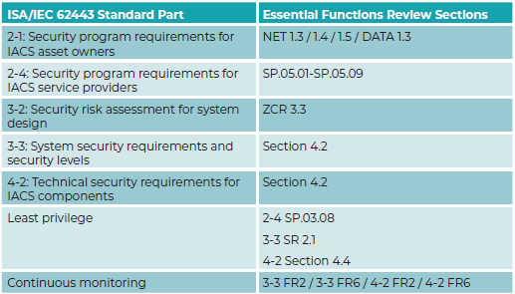
Essential Functions & Zero Trust
Essential Functions according to the ISA/IEC 62443 standard are “functions or capabilities required to maintain health, safety, the environment and availability of the equipment under control.”
Examples include:
Safety instrumented functions (SIF)
Control function
Ability of the operator to view and manipulate the equipment under control

Slide 10
Cost & Benefit Considerations for Zero Trust in OT
Establishing context for ZT in the ICS and OT world
Cautions concerning operator fatigue
Implementing zero trust requires resources, buy-in from leadership and two technical foundations to build upon:
Asset inventory
An understanding of known threats and vulnerabilities
Notes:
In the context of industrial control, zero trust brings additional considerations. In many industrial sectors, the application of concepts such as CIA — confidentiality, integrity and availability — are inverted and morphed into safety, availability, integrity and confidentiality (SAIC). Care is essential as a newly introduced interaction for authentication might be a minor difference in the IT space. Still, it can result in a negative performance difference or safety concern in the industrial world.
Creating overly complex and burdensome controls leads to end-user fatigue, wasted resources and inefficiencies. When implementing zero trust, like any ICS solution, attention to the user experience will help ensure seamless adoption of these controls. Appropriate security automation, screen flow and efficient interactions will all reduce adverse reactions to zero trust controls. Segmentation ensures network and access boundaries between OT/ICS operations and enterprise resources and networks, dispersed operations and facilities, as well as secure remote access

Slide 11
Cost & Benefit Considerations for Zero Trust in OT
When availability is paramount, applying ISA/IEC 62443 to OT networks requires dividing assets into zones and conduits.
Zones - A grouping of logical or physical assets that share standard security requirements based on criticality and consequence, among other characteristics.
Conduits - Groupings of assets dedicated exclusively to communications that share security requirements.
ISA/IEC 62443, used as a tool, helps organizations strategically look at how zones operate and how our networks communicate, access is managed, devices discovered and identified, and protocols used to understand their behaviors better and inform the controls chosen.

Slide 12
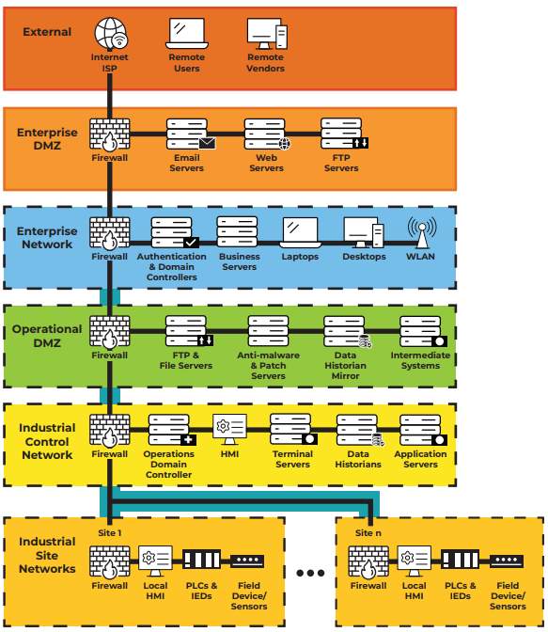
Cost & Benefit Considerations for Zero Trust in OT
Using ISA/IEC 62443 principles, you are assured that the intrinsic security capabilities necessary to achieve your zero trust architecture are already available
The ISA/IEC 62443 model of security zones and conduits offers a granular approach for evaluating devices and systems capable of incorporating zero trust principles and assigning appropriate controls that can be implemented within an ICS/OT environment.
Notes:
Authentication, identification, access controls

Slide 13
Implementation Strategy: Zero Trust Application Contexts
Zero Trust can be applied in many areas within a typical automation application, but some more easily than others
Secure Remote Access
Zone / Perimeter Control
Intra Zone / Controller-to-FieldDevice

Slide 14
Implementation Strategy: Perimeter Building Blocks
I understand my trust zones, how do I build perimeters?
Secure Remote Access
Bespoke Secure Remote Access solutions
Secure Service Edge
VPN
Zone / Perimeter Control
Firewall
Zone Perimeter Device
Secure Industrial Protocol
Intra Zone / Controller-to-FieldDevice
Secure Industrial Protocol

Slide 15
Conclusion
Using ISA/IEC 62443 principles, you can be assured that the necessary security capabilities for achieving a zero-trust architecture are available
The implementation of zero trust involves additional upfront and maintenance costs as it elevates security dimensions and magnitude, but it also offers significant benefits in terms of understanding and organizing a security strategy.
In a cybersecurity landscape crowded with different opinions, zero trust can bring order and coherence to a policy enforcement approach, leading to short-term gains and long-term improvements in cyber posture.
ISA/IEC 62443 and zero trust go hand in hand for success. Every organization should prioritize visibility of all mission-critical and business-critical processes and implement appropriate cybersecurity controls.
As discussed today, zero trust maturity covers a wide range of cyber-defense topics, ensuring that a balanced and proven set of cyber controls addresses ICS/OT defensive needs.

Slide 16
In Memoriam of Michael Chaney (Idaho National Labs), who contributed to Zero Trust Outcomes Using ISA/IEC 62443 Standards whitepaper. ISAGCA and authors were saddened to hear that co-author Michael Chaney passed away in early 2024. We want to acknowledge his efforts as a ISAGCA member and founding member of the ICS4ICS team. We encourage leaders to continue to learn from his strategic support and impacts on our industry.

Slide 17
Questions/Answers

Slide 18
Be Part of the Movement to Prioritize OT Cybersecurity
Change the Culture
Recognize cybersecurity as a fundamental workplace tenet alongside functionality, efficiency, and safety
Learn more | www.isagca.org

Slide 19
ISA Cybersecurity Resources
Free guidance, training, and more:
ISA Global Cybersecurity Alliance - www.isagca.org A collaborative forum to advance OT cybersecurity and understanding of ISA/IEC 62443 | ISASecure www.isasecure.org The world’s leading conformance certification program for ISA/IEC 62443 | ICS4ICS www.ics4ics.org Improve how cybersecurity incidents are managed with training, processes, and exercises
Get involved:
ISA/IEC 62443 standards available from ISA (free access with ISA professional membership!)
Cybersecurity training and certificate program
Help develop the standard – open to all at no charge – www.isa.org/ISA99

